Slide 1
K –MEANS
EXCLUSIVE-CLUSTERING ALGORITHM

Slide 2
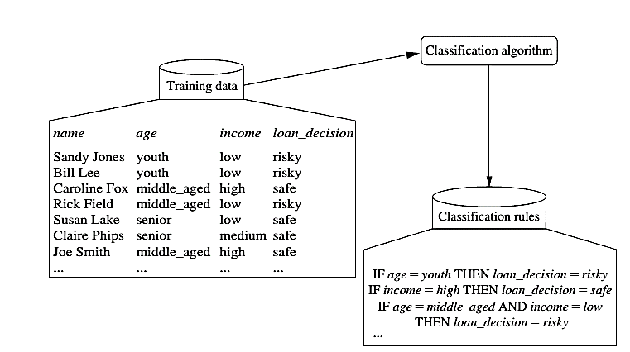
Classification Steps:
Learning

Slide 3
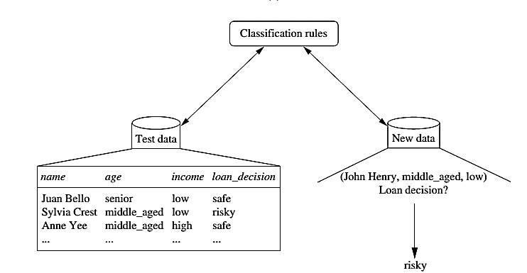
Classification

Slide 4



Process (1): Model Construction
Classification
Algorithms
Training
Data
Classifier
(Model)
IF rank = ‘professor’
OR years > 6
THEN tenured = ‘yes’

Slide 5


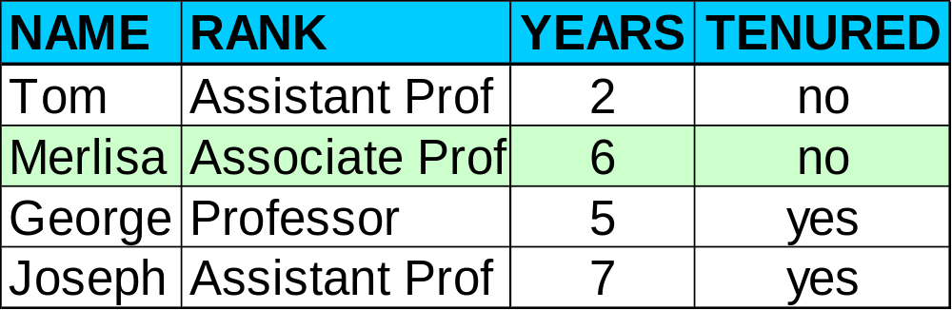

Process (2): Using the Model in Prediction
Classifier
Testing
Data
Unseen Data
(Jeff, Professor, 4)
Tenured?

Slide 6
Supervised vs. Unsupervised Learning
Supervised learning (classification)
  Supervision: The training data (observations, measurements, etc.) are accompanied by labels indicating the class of the observations
  New data is classified based on the training set
Unsupervised learning (clustering)
  The class labels of training data is unknown
  In this we can predict the class labels by using clustering technique.

Slide 7
K –MEANS ALGORITHM
Simplest unsupervised learning algorithms
Easy way to classify a given data set through number of cluster observations into groups of related observations
Complexity is O( n * K * I * d )
n = number of points, K = number of clusters,
I = number of iterations, d = number of attributes
Medical imaging, biometrics and related fields

Slide 8
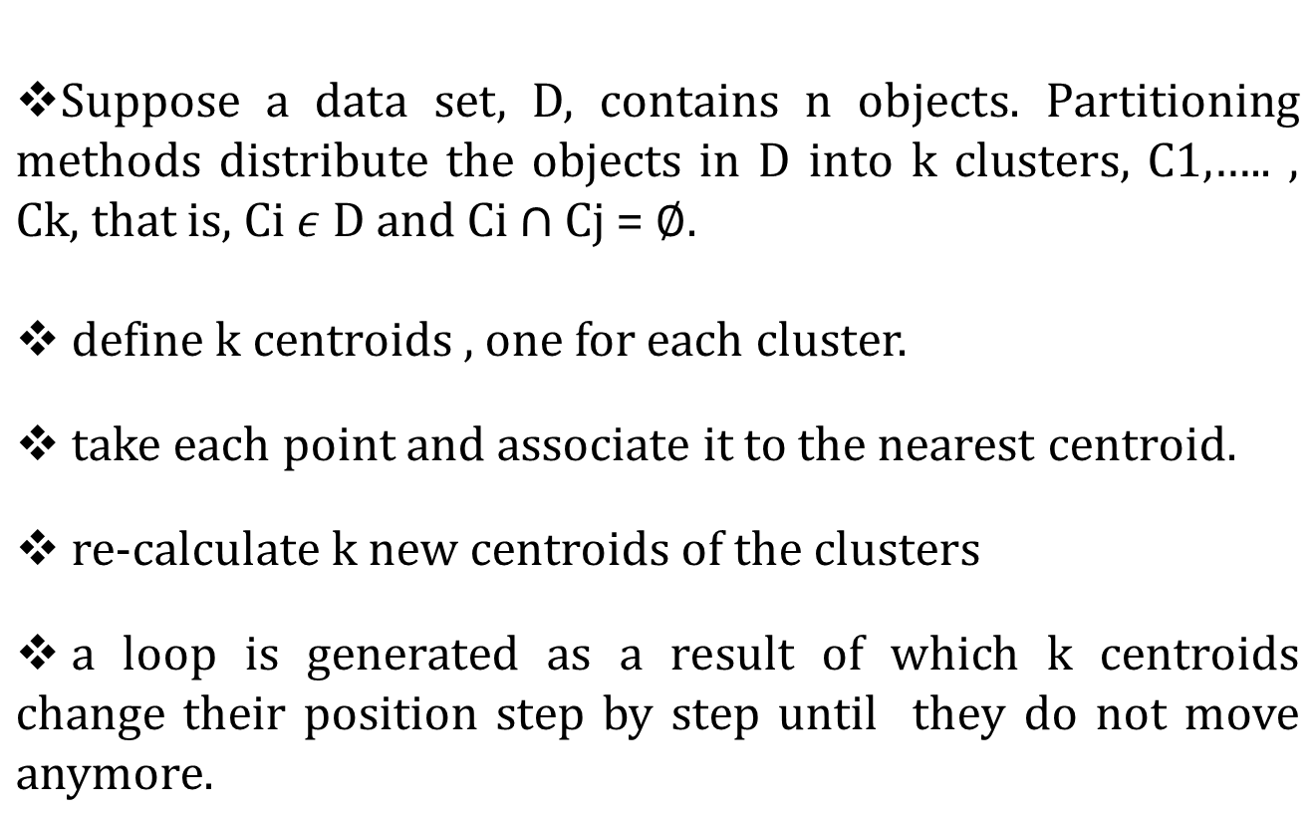
HOW IT WORKS ????

Slide 9



Finally this algorithm aims at minimizing an objective function
or
Where is choosen distance measure between data point
and the cluster centre is an indicator of the distance of n
data points from respective cluster centres.

Slide 10
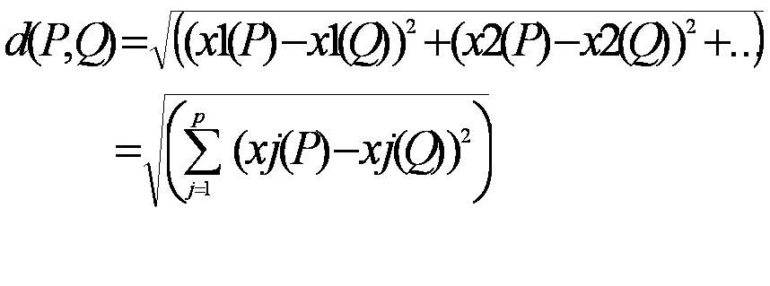
Let m_{i} be the mean of the vectors in cluster i
m_{i} is calculated randomly by using
    Euclidian metric: The commonly used distance measure is the Euclidean metric (mostly in case of multi-dimensional data)which defines the distance between two points
    P= ( x1(P), x2(P),…) and Q = ( x1(Q),x2(Q),…) is given by:

Slide 11
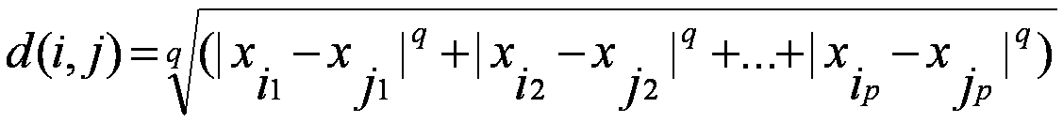

    Minskowski distance:
      where i = (x_{i1}, x_{i2}, …, x_{ip}) and j = (x_{j1}, x_{j2}, …, x_{jp}) are two p-dimensional data objects, and q is a positive integer
    Manhattan distance:
      If q = 1 , d gives the Manhattan distance

Slide 12
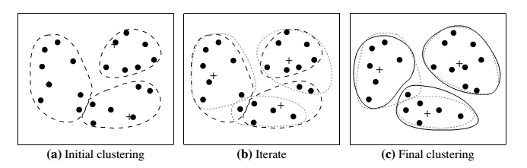
Example

Slide 13
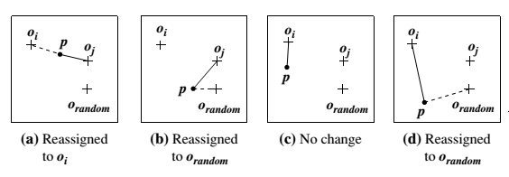
K--MEDOID CLUSTERING
The k-means algorithm is sensitive to outliers because such objects are far away from the majority of the data, and thus, when assigned to a cluster, they can dramatically distort the mean value of the cluster.
In this we choose one representative per cluster and rearrange the cluster objects.

Slide 14
Hierarchical Clustering
Use distance matrix as clustering criteria. This method does not require the number of clusters k as an input, but needs a termination condition
Step 0
Step 1
Step 2
Step 3
Step 4
agglomerative
(AGNES)
a
a b
b
a b c d e
c
c d e
d
d e
e
divisive
(DIANA)
Step 4
Step 3
Step 2
Step 1
Step 0

Slide 15
Hierarchical Clustering
Clusters are created in levels actually creating sets of clusters at each level.
Agglomerative
  Initially each item in its own cluster
  Iteratively clusters are merged together
  Bottom Up
Divisive
  Initially all items in one cluster
  Large clusters are successively divided
  Top Down

Slide 16
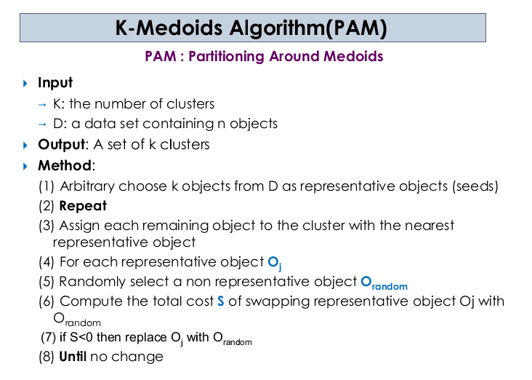

Slide 17
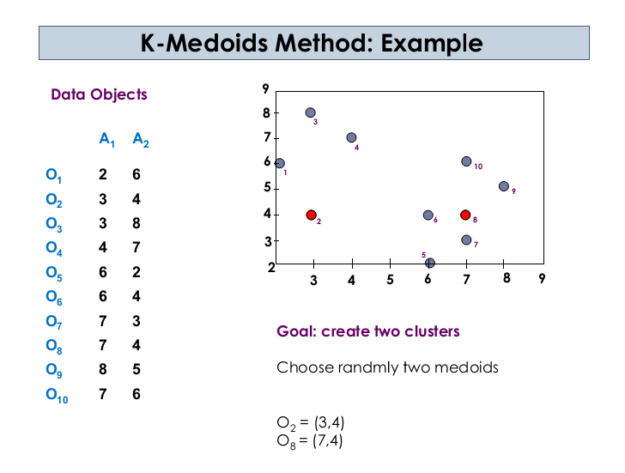

Slide 18
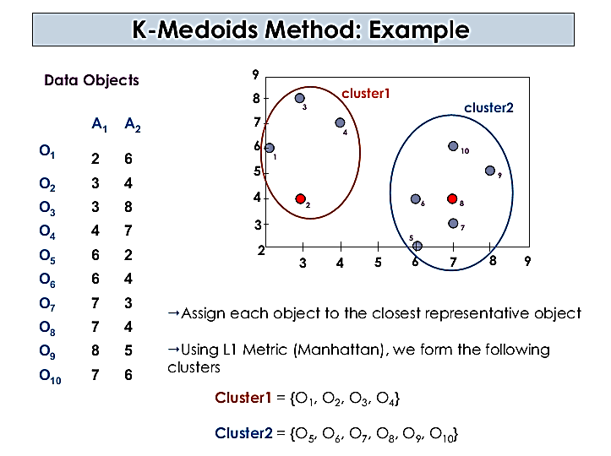

Slide 19
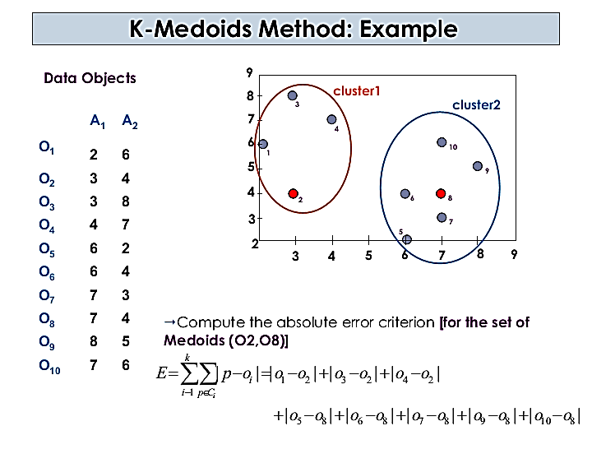

Slide 20
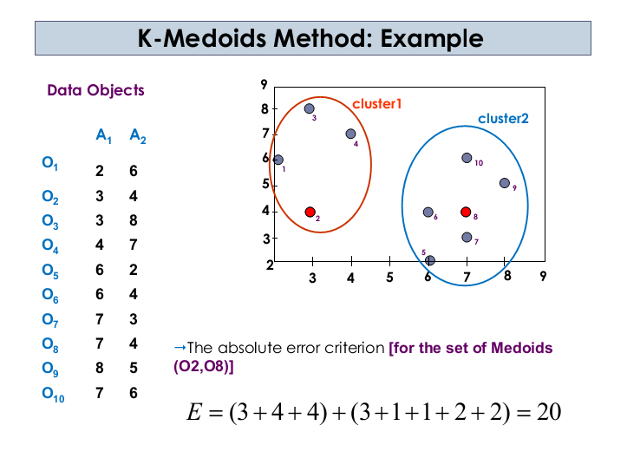

Slide 21
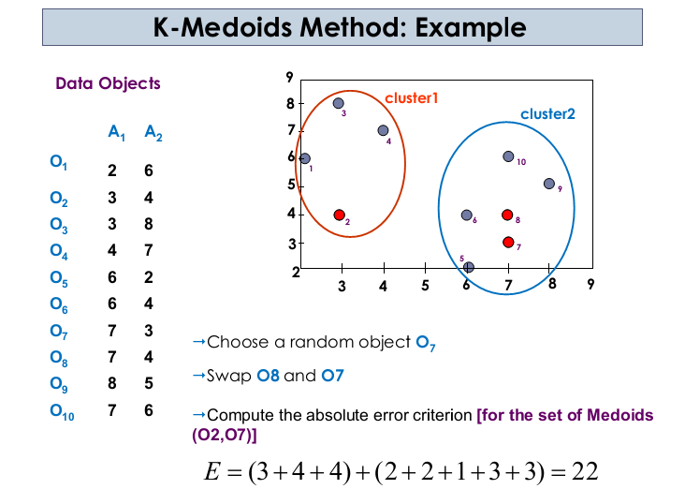

Slide 22
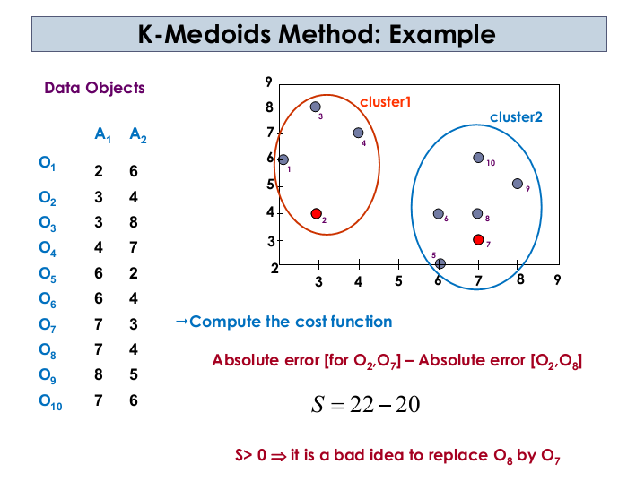

Slide 23
“Which method is more robust—k-means or k-medoids?”
The k-medoids method is more robust than k-means.
Because in the presence of noise and outliers medoid is less influenced by outliers or other extreme values than a mean.

Slide 24
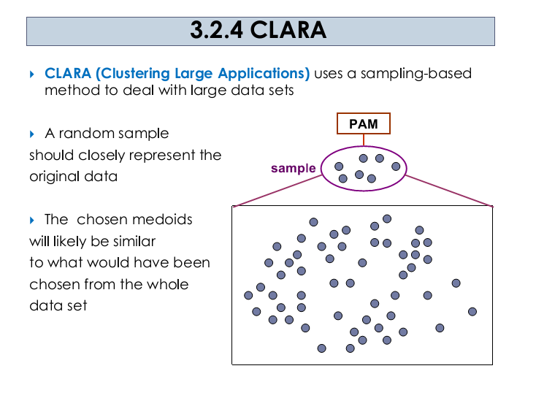

Slide 25
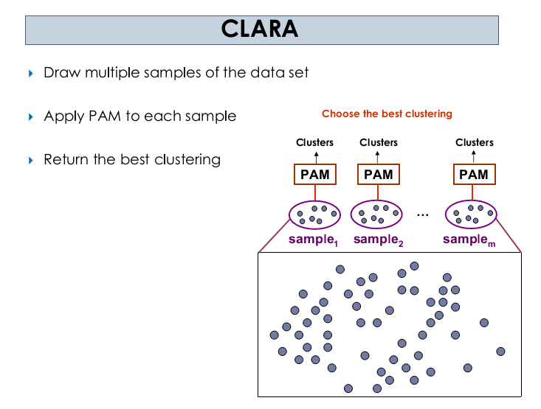
In many cases, a large sample works well if it is created so that each object has equal probability of being selected into the sample.

Slide 26
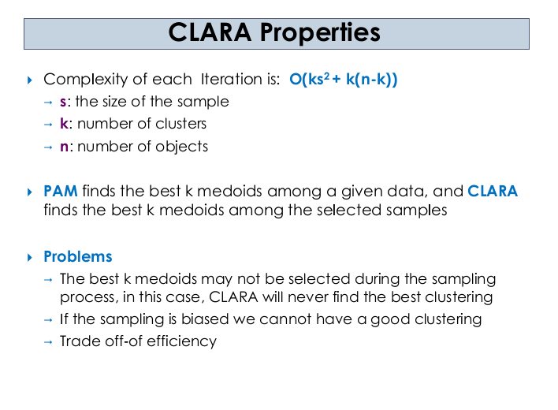

Slide 27
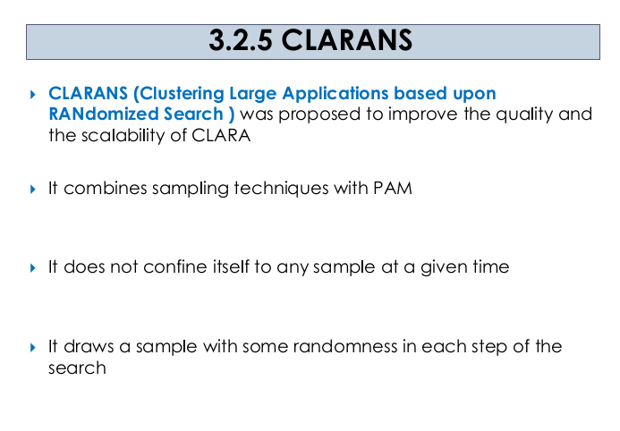

Slide 28
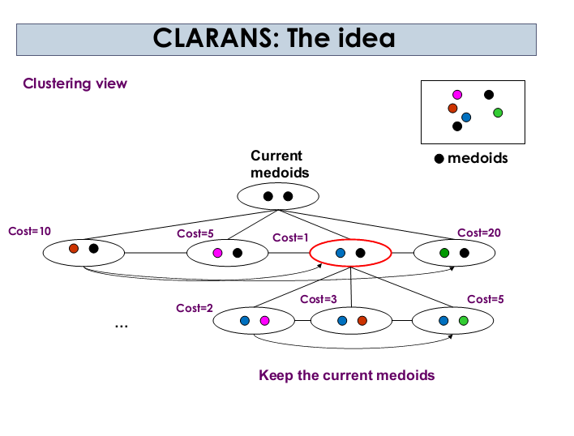

Slide 29
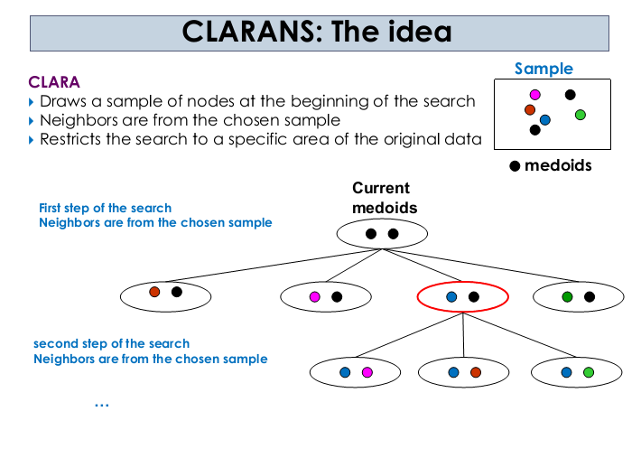

Slide 30
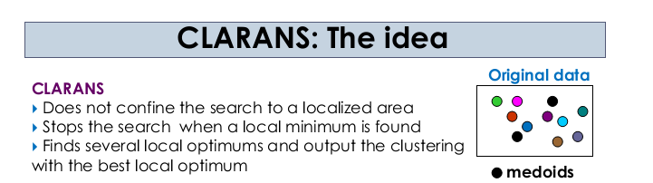

Slide 31
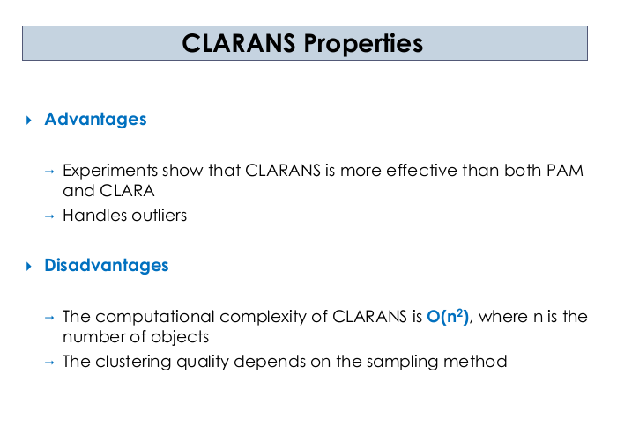

Slide 32
Data Warehousing – Tuning
As data warehousing is an emerging area, a lot of problems are found in the system. One of the major problems faced by the industry today is data warehouse maintenance.
Difficulties in Data Warehouse Tuning
The data warehouse never remain constant throughout the period of time.
It is very difficult to predict that what query the user is going to produce in future.
The need of the business also changes with time.
The users and their profile never remains the same with time.
The user can switch from one group to another.
the data load on the warehouse also changes with time.

Slide 33
Tuning Mechanisms
Performance Assessment
Here is the list of objective measures of performance.
Average query response time
Scan rates.
Time used per day query.
Memory usage per process.
I/O throughput rates
Data Load Tuning
Data Load is very critical part of processing.
Nothing else can run until data load is complete.
This is the entry point into the system.
Integrity Checks
The integrity checking highly affects the performance of the load

